Slide 1
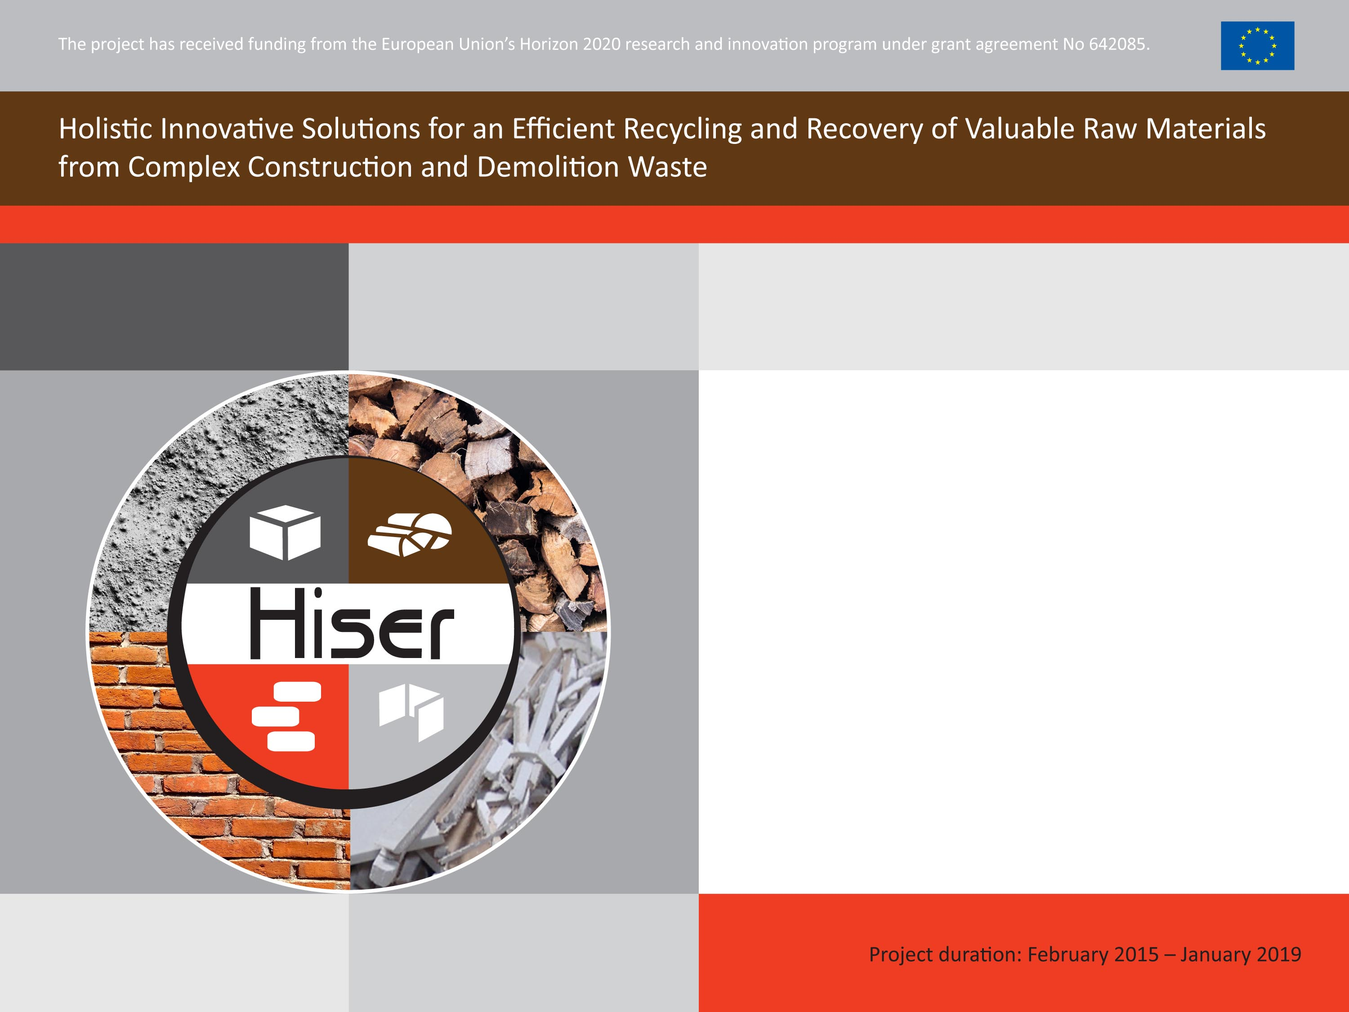
HISER project
Author..
Date…

Slide 2

What is HISER?
Holistic Innovative Solutions for an Efficient Recycling and Recovery of Valuable Raw Materials from Complex Construction and Demolition Waste (HISER) project is co-financed in the framework of the biggest EU Research and Innovation Programme - Horizon 2020.
HISER project is an answer to European challenges that have been identified in the construction and demolition sector such as:
the need to move towards highly efficient paradigms of recovery of valuable raw materials in priority waste streams within the EU28,
the need for progress in novel recycling technologies for complex Construction and Demolition Waste,
the need for novel solutions stimulating selective sorting at source of materials arising from demolition and refurbishment works.

Slide 3
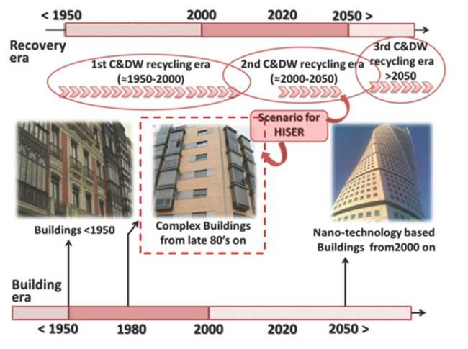
What is HISER?
The center of gravity of HISER overlays innovation and demonstration activities aiming to bridge current obstacles to higher levels of recovery of raw materials from complex End-of-Life buildings and derived C&DW, as well as its subsequent commercialization in new building products through circular paradigms, covering the existing gaps within the whole supply chain.

Slide 4
HISER objectives
The main objective of HISER is to develop and demonstrate novel cost-effective holistic solutions (technological and non-technological) to increase the recovery rates from increasingly complex Construction and Demolition Wastes (C&DW), according to the principles of circular economy approach throughout the whole value chain in the construction sector.
The following solutions are proposed within the project:
harmonized procedures, supplemented by an intelligent tool and systems for traceability of the supply chain, for highly-efficient sorting at source in demolition and refurbishment works,
advanced sorting and recycling technologies with automated quality control for the production of high purity raw materials from complex C&DW,
development of optimized construction products (such as low embodied energy cements, green concretes, bricks, gypsum plasters and gypsum plasterboards or extruded composites) with higher rates of recycled materials.

Slide 5
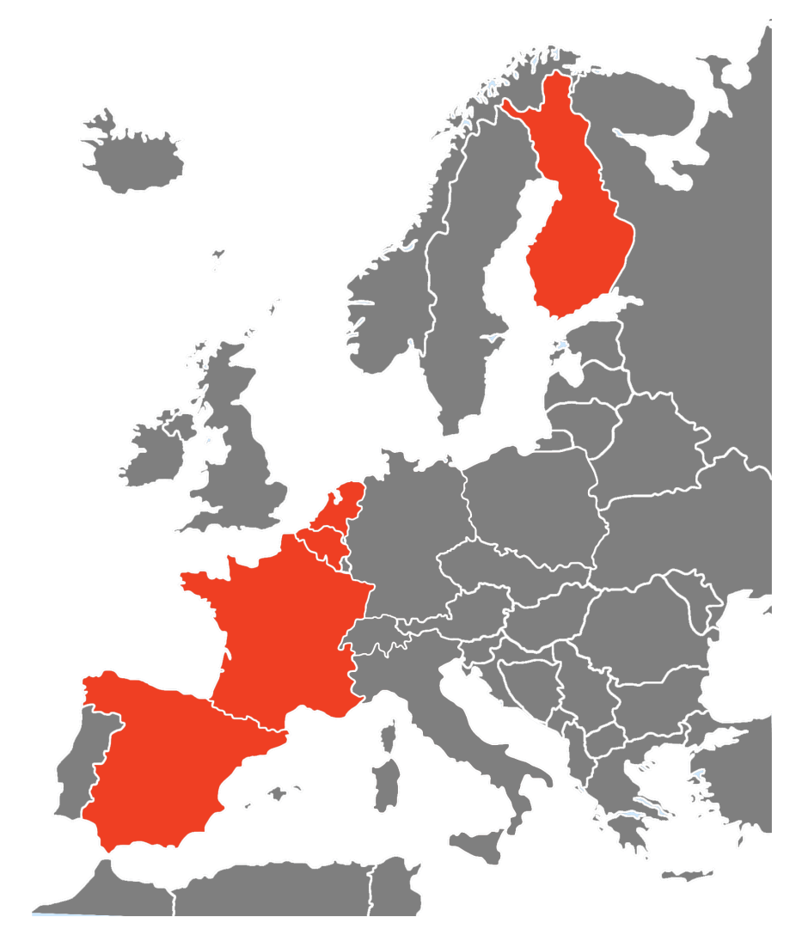
HISER objectives
The proposed solutions will be demonstrated in 5 case studies across Europe (Belgium, The Netherlands, Spain, France and Finland) in demolition and recycling projects.
Moreover economic and environmental impact of HISER solutions will be quantified from a viewpoint of lifecycle (LCA / LCCA) and recommendations for European standardization policies and standards for the implementation of the best solutions will be proposed.

Slide 6
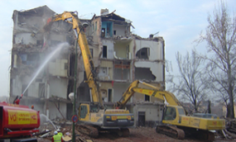



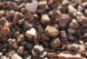




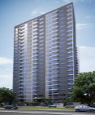
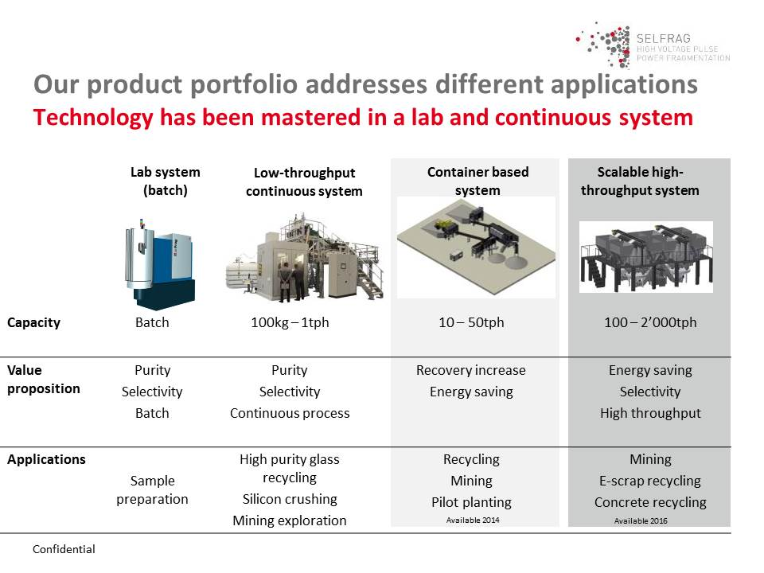



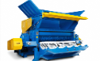











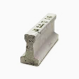



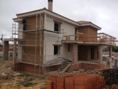
HISER at first glance
NOVEL TOOLS
SELECTIVE DEMOLITION
WP2
European
Policies
Smart BIM-SD Platform
BIM-SD
BIM Wearable Editor
Smart BIM-SD Analyser
WM-DB
NEW BUILDING
WASTE
STONY FRACTION
GYPSUM
WOOD
MINERAL WOOL
GLASS
SUPPLY CHAIN TRACKING
INDUSTRIAL AND SOCIAL AWARENESS
WP3
RAW MATERIALS
AUTOMATED QUALITY ASSESSMENT
GREEN PUBLIC PROCUREMENT
AGGREGATES
METAL
GYPSUM
CARDBOARD
WOOD FIBERS
FILLER/
FIBERS
SILICA
European
Policies
HIGH-PURITY MATERIALS
BUILDING PRODUCTS
EXPLOITATION
NEW GREEN BUILDING PRODUCTS
WP7
BRICKS
LOW EMBODIED CEMENT
CONCRETE
PLASTERBOARD/GYPSUM PRODUCTS
WP COMPOSITES
CEMENT
DEMONSTRATION
WP4
WP6
LC and LCC assessment
WP5

Slide 7
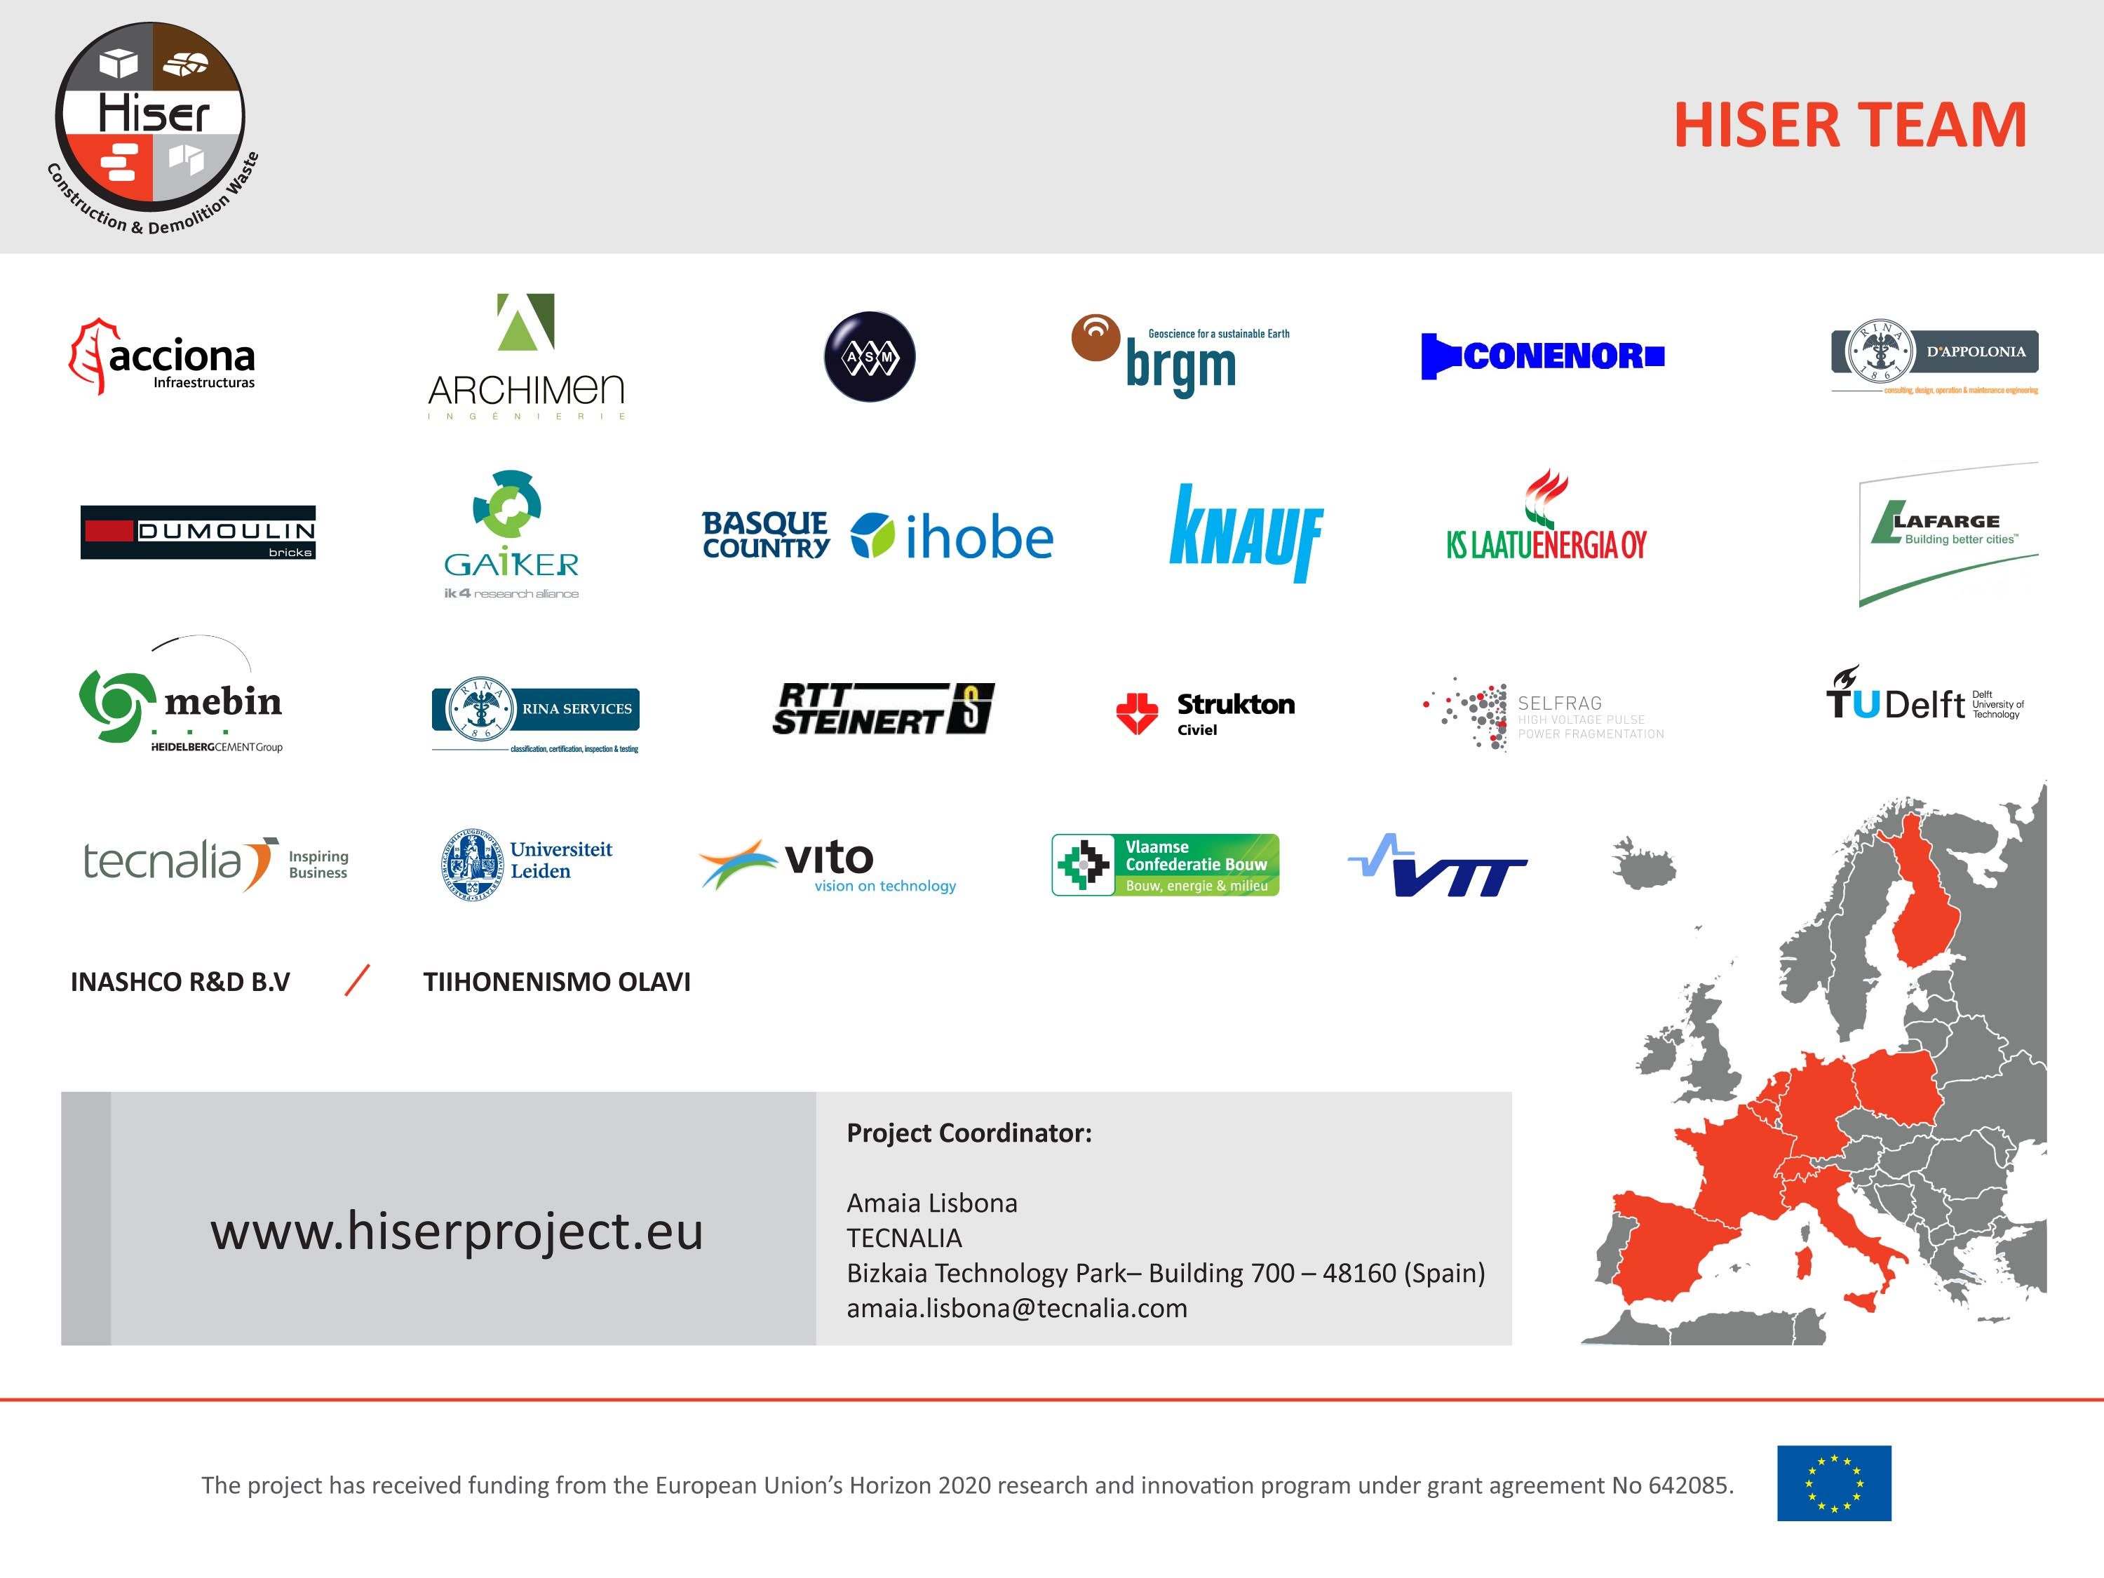

Notes:
HISER Consortium includes 25 partners from 10 European countries. Project Partners represent the construction and demolition sector, including experts in software development, recycling technologies, associations, contractors and manufacturers of construction products are present in the HISER project.

